Slide 1
C#
Matt McNeive

Slide 2

Background
Designed by Anders Hejlsberg in 1999
First released in 2002 by Microsoft for their own use alongside Microsoft Visual Studio 2002 on the .NET 1.0 framework
Replaced Visual C++ and Visual Basic within the Microsoft ecosystem
Similar to C++ and Java and was in heavy competition with Java for recognition

Slide 3
Rationale
Designed to keep business needs in mind
  Supports web, mobile, and app development
  Easily deployable cross-platform as well as in the cloud and containers
Regularly updated to stay modern
  Open-source with active community, governed by Microsoft
Meant to be simple, easy to use, and readable, avoids complexity and unstructured language features
Fast when compared to other high-level languages

Slide 4
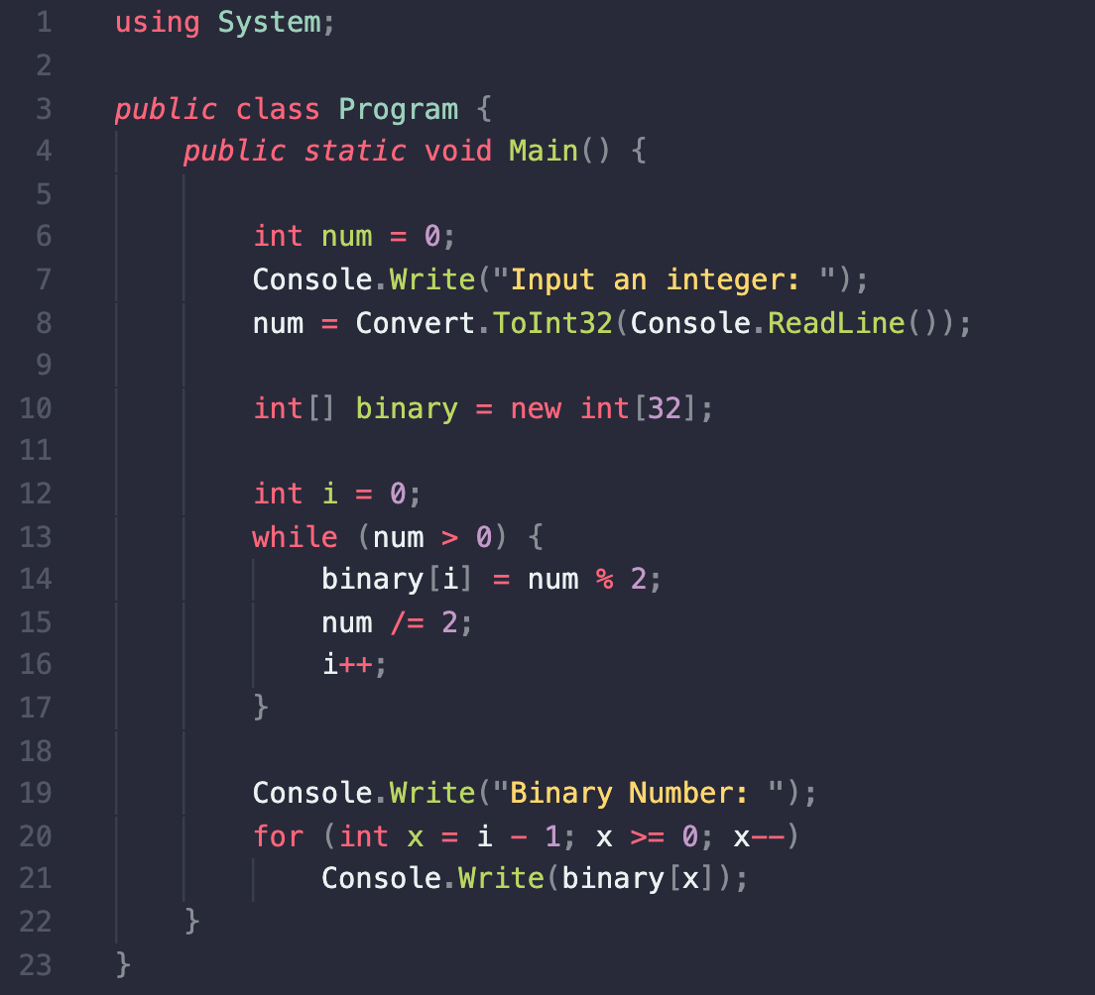
Code Sample

Slide 5
Design Principles
In 2002, C# was approved as an international standard by ECMA
Object Oriented language
Designed for imperative programming, but has functional support
Statically typed
Writing applications for both hosted and embedded systems
Economical for memory and processing power

Slide 6
Design Principles
Automation: Visual Studio and .NET allow for automation testing in C#
Orthogonality: Most operations only affect themselves or things within its scope, has support for static (global) variables
Portability: Build to run on any platform
Regularity: Contains rules, especially concerning type
Security: Statically-typed, garbage collection
Simplicity: Core belief, based off C++ and Java

Slide 7
Evaluation
26/30
Readability: 5/5
Writability: 4/5
Reliability: 5/5
Cost: 4/5
Portability: 4/5
Community: 4/5

Slide 8
Sources
Arora, Simran Kaur. “C# Vs Java: Differences You Should Know.” Hackr.io, https://hackr.io/blog/c-sharp-vs-java.
Chand, Mahesh. “What Is C#.” C# Corner, https://www.c-sharpcorner.com/article/what-is-c-sharp/.
Friedman, Janice. “When Was C# Created? A Brief History.” C# Station, 18 Mar. 2020, https://csharp-station.com/when-was-c-sharp-created-a-brief-history/.
“Selenium with C# Tutorial - Javatpoint.” Www.javatpoint.com, https://www.javatpoint.com/selenium-csharp.

Slide 9
Thank You

